Slide 1
ENGR-E 583: Information Visualization
Predictive Pricing Model - Group 25
Enhancing Pricing Strategies through Data-Driven Insights
Client and Project Sponsor: Opinion Route
Presented By
Faizan Waheed, Sai Bhavya Sree, Shamika Karnik, Shoukath Ali Shaikh, Swamini Sontakke
INDIANA UNIVERSITY BLOOMINGTON

Slide 2
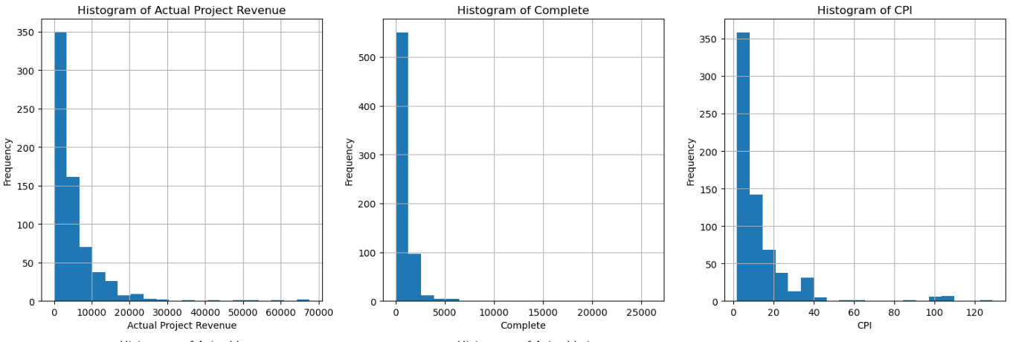
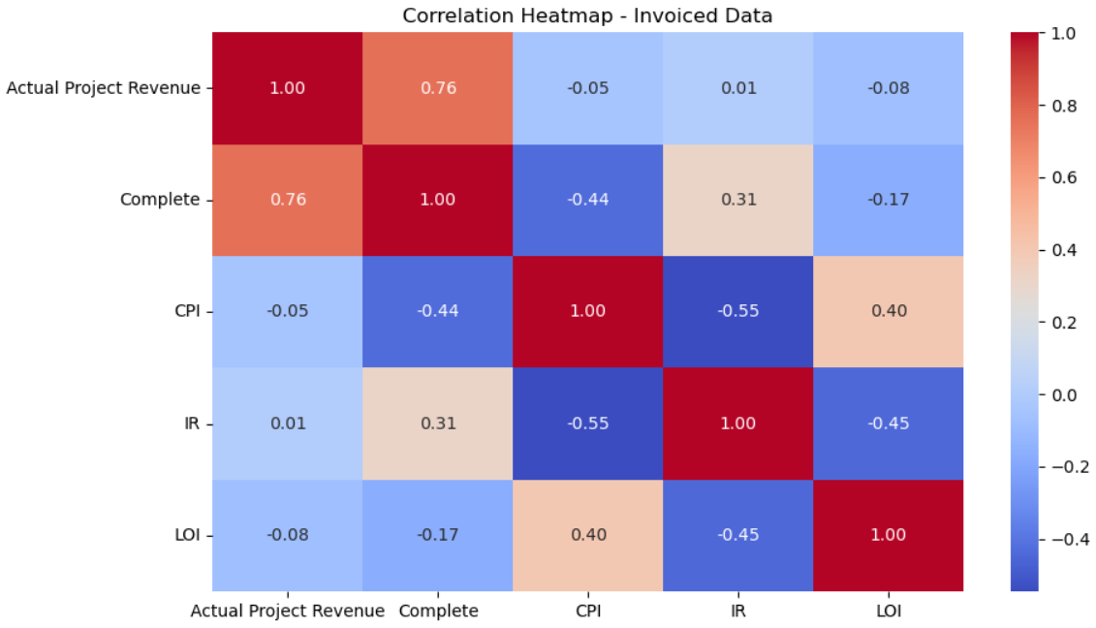
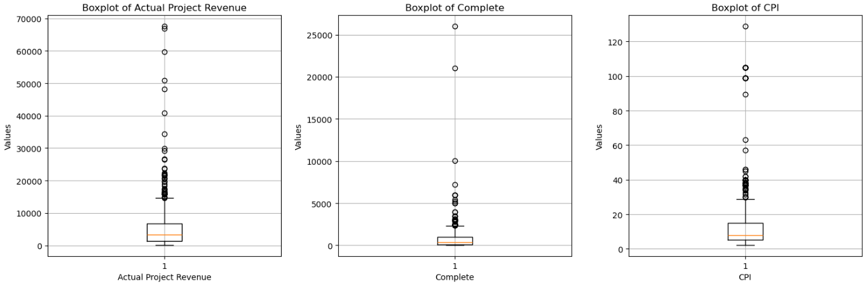
Stakeholder(s) and their needs
Data, Statistics, Preprocessing & Analysis
Sales & Account Managers: Optimize deal pricing, understand lost deals, suggest competitive rates
Pricing Analysts: Develop data-driven pricing strategies using lost deal data
Finance Team: Ensure profitability by analyzing revenue, costs, and margin impact
Marketing Team: Identify pricing trends to refine promotional strategies
Senior Management: Strategic decision-making based on pricing performance
3 Data Files: Invoiced deals (600+ records), Lost Deals (2500+ Records), Account Segments(100+ Records)
Key Metrics: CPI (Cost Per Interview), LOI (Length of Interview), IR (Incidence Rate), Complete (No of interviews completed), Respondent Type

Slide 3
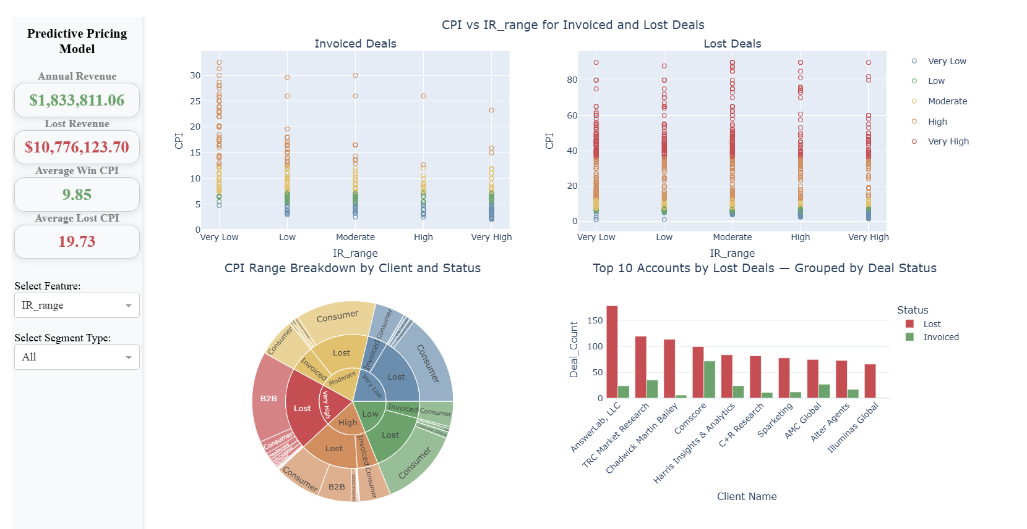
Final Results - Dashboard

Slide 4
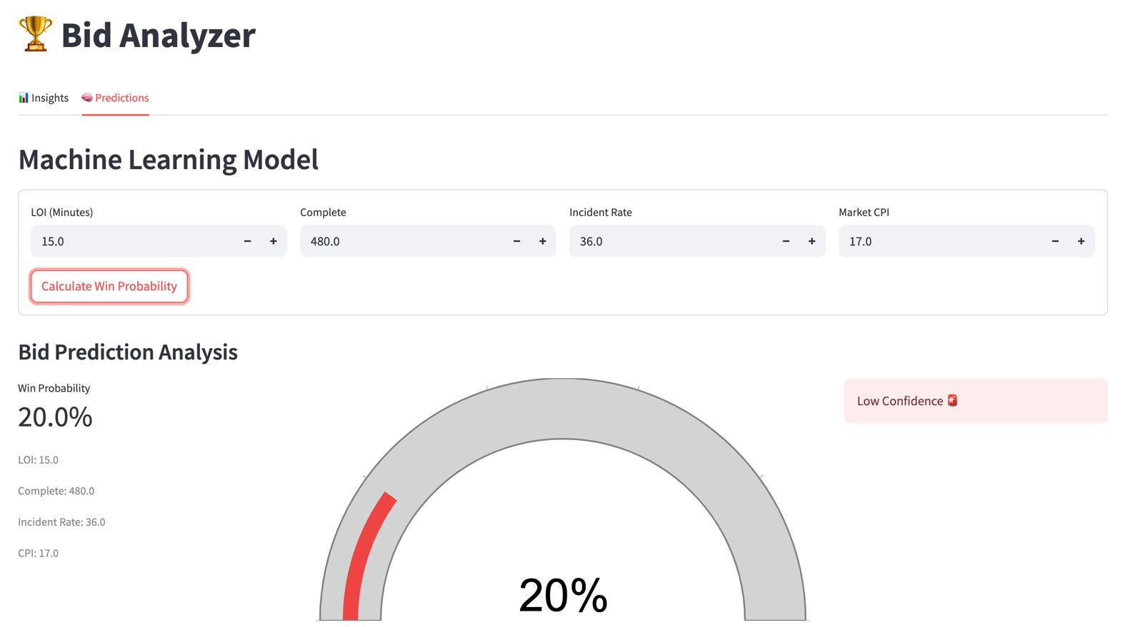
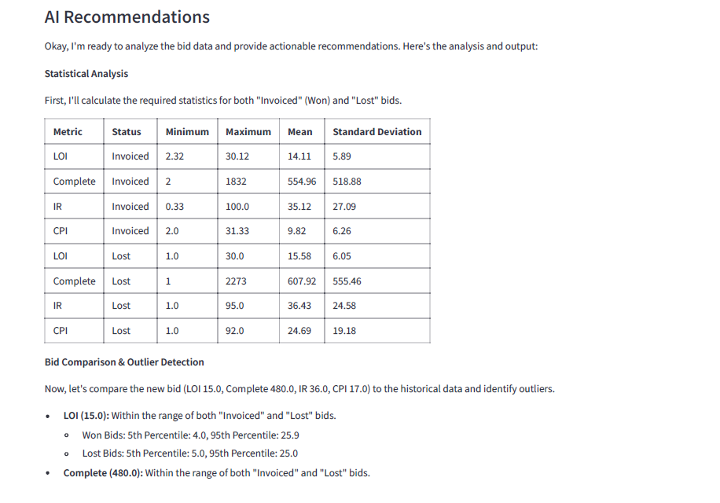
Final Results - ML Prediction and LLM Recommendation
Random Forest Model:
Trained to predict winning probability.
Fine-tuned parameters like n_estimators, managed bias/variance.
Optimized with Grid Search CV on train/test/validation splits.
Gemini AI (LLM):
Tuned using prompt engineering with parameters like temperature, top_p, and top_k.
Provided summary datasets and key metrics for better responses.
Tested multiple prompts and deployed the best-performing one.
ML and LLM Integration:
Supplied LLM with feature inputs and Random Forest outputs.
Enabled AI to generate informed, reasoning-based suggestions.

Slide 5
Key Insights
Challenges Faced
CPI - Consistently high for lost deals while comparatively low for Invoiced deals
CPI - Strongly impacted by IR and LOI. Lower the IR → higher the CPI, higher the LOI → higher the CPI
Most Deals are won when CPI values are not very high.
There is no single client which has more Invoiced deals than lost deals
Consumer and B2B are the largest respondent types for lost deals
Unclear Requirements - Took a long time to understand the actual requirement from the client
Irrelevant features - Irrelevant fields were provided, which had to be handled through feature engineering
Inconsistent Data: Invoiced deals had only 1 respondent type, Lost deals had no dates and location details
On the go additions - client provided new data recently
Limited LLM access - monthly usage restriction

Slide 6
LINKS
Github
Report
Dashboard

Slide 7
Thank you!

